Slide 1


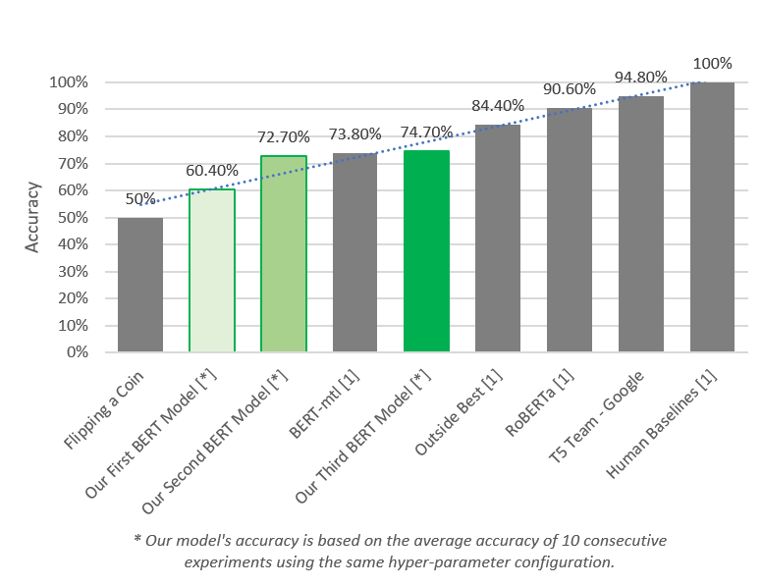
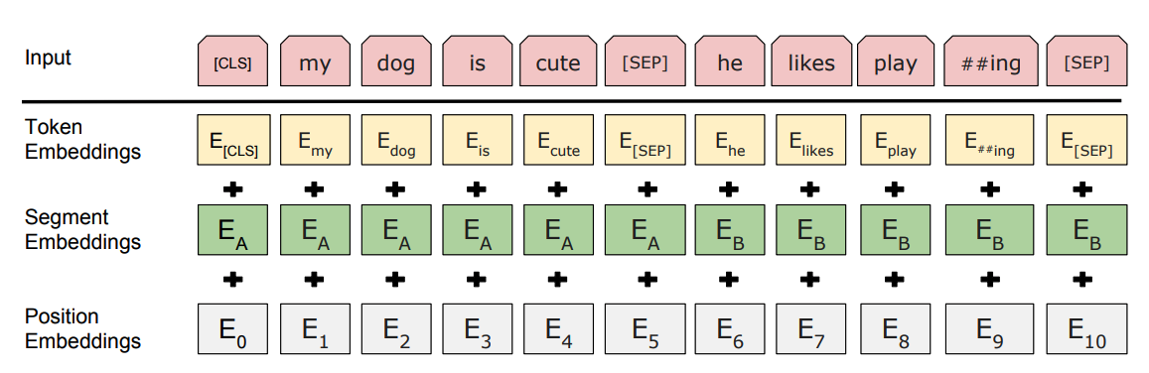
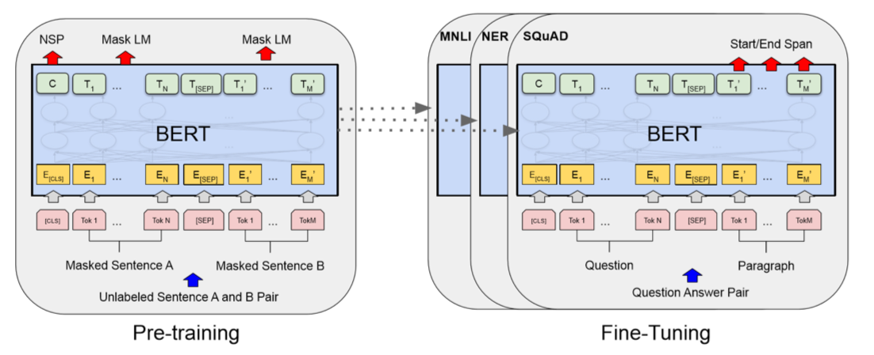
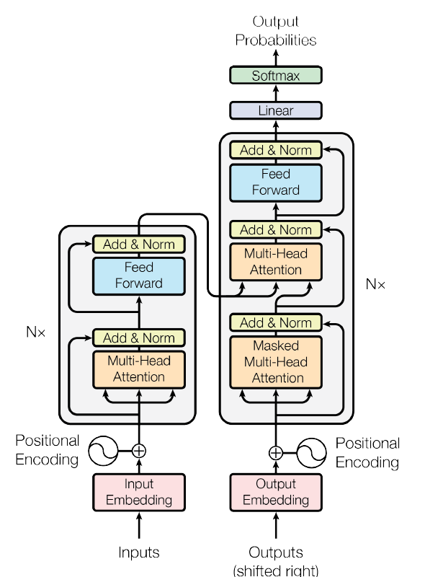
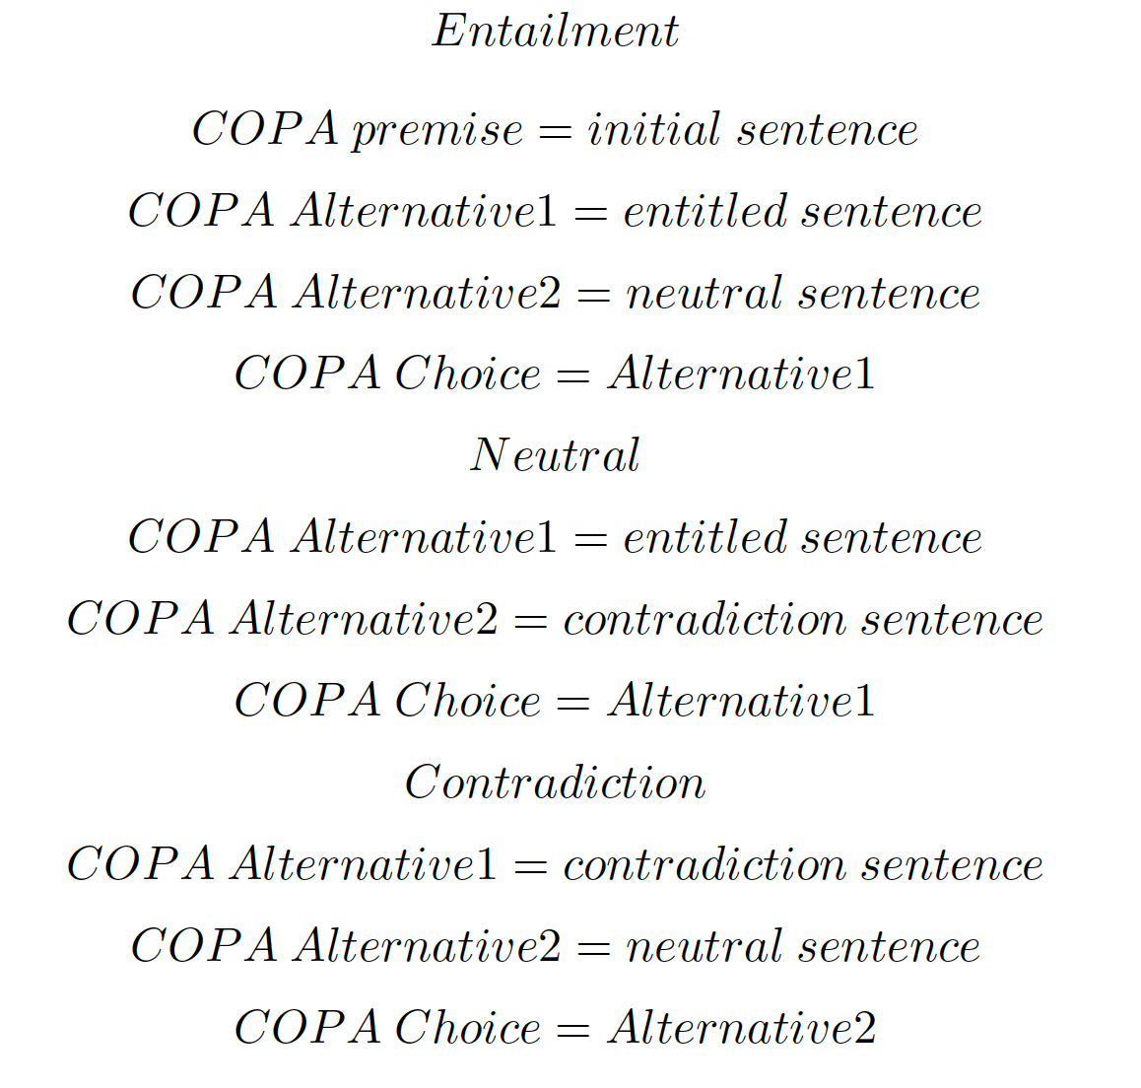
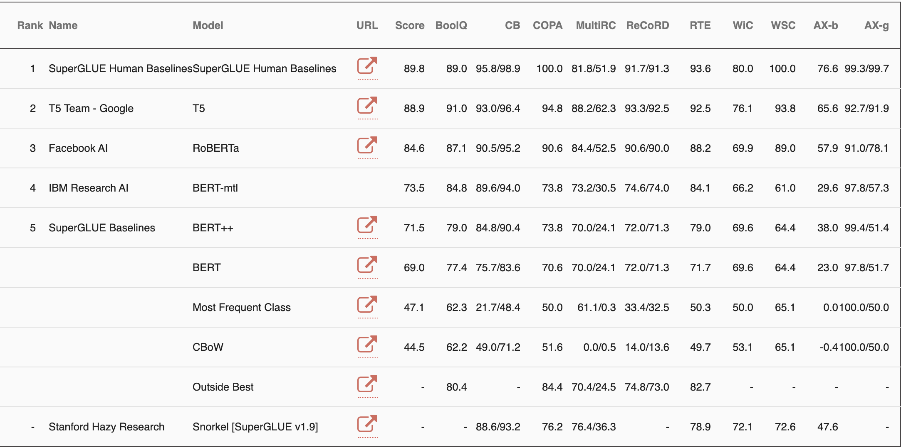
Choice of Plausible Alternatives
Li, Yansong; Qu, Shuzheng; Su, Xuanyu;
Yang, Siyuan; Linkletter, Maurice
SUMMARY
COPA
BERT
RESULTS
We chose to do one of the SuperGLUE tasks
Choice of Plausible Alternatives (COPA)
Our approach is based on the BERT language model
BERT is an open source language model created by Google
BERT stands for: Bidirectional Encoder Representations from Transformers
We have improved our model’s accuracy from 60.4% to 74.7% using an Agile development process.
By pre-training our model on a large set of MultiNLI data we have been able to improve our model’s accuracy by 2%
For future work we would like to use RoBERTa rather then BERT.
RoBERTa is Facebook’s implementation of the BERT model and it currently holds second place on the SuperGLUE leader board.
Choice of Plausible Alternatives (COPA)
The COPA task provides researchers with a tool for assessing progress in open-domain common-sense causal reasoning.
COPA consists of 1000 questions, split equally into development and test sets of 500 questions each.
Each question is composed of a premise and two alternatives, where the task is to select the alternative that more plausibly has a causal relation with the premise.
The correct alternative is randomized so that the expected performance of randomly guessing is 50%.
COPA example:
Premise: The man broke his toe. Type: Cause
Alternative 1: He got a hole in his sock. Alternative 2: He dropped a hammer on his foot.
Premise: I tipped the bottle. Type: Effect Alternative 1: The liquid in the bottle froze. Alternative 2: The liquid in the bottle poured out.
Premise: I knocked on my neighbor's door. Type: Effect Alternative 1: My neighbor invited me in. Alternative 2: My neighbor left his house.
BERT (Bidirectional Encoder Representations from Transformers) is an open source language model created by Google.
Input representation can be composed of three-part Embedding summation.
Pre-training: trained on unlabeled data (unsupervised learning);
Fine-Tuning: using labeled data from the downstream tasks.
CONCLUSIONS
By applying model fine-tuning approach with MutiNLI data and implementing with Agile Development process, we successfully reach the new state-of-the-art of BERT model on COPA task.
We hypothesize that precise common sense comprehension detectors should be designed following four principles:
1. Appropriate word embedding format;
2. Interpretative sentence transformer;
3. Iterable training classification layer with softmax output;
4. Sufficient trainable COPA data for the fine-tuning process.
In the future, we will further study what architecture makes a good common-sense comprehension detector, how to enhance data interpreting ability with appropriate transformer and efficiency improvement of our BERT module.
OUR APPROACH
We researched create state-of-the-art approaches for the COPA task.
We choose to base our implementation on BERT_{_base} pre-trained Language model [3].
Data pre-processing to add additional categorization to our training and evaluation data.
Our model is comprised of 4 major components.
Data pre-processing
Linear Transformation layer
BERT language model layer(s).
A classification layer (learned matrices of weights and biases) with a Softmax output.
Used an Agile Development process to iterate on our model’s implementation.
Using this Agile process we have been able to increase our model’s accuracy from 60.40% to 74.70%.
Generated an additional 10,000 pieces of training data from the MultiNLI dataset [4]
Using the MultiNLI training data we were able to improve our model’s accuracy from 72.7% to 74.7%.
We are also attempting to improve our model’s accuracy by use WordNET as a in-memory model in data pre-processing. This is a work in progress and a stretch goal for the project.
Bert uses transformer model which
has the encoder-decoder architecture. Attention strategy helps the current node not only focus on the current word, but also obtain the semantics
of the context.
Both encoder and decoder share the same number in network depth.
Both consists of two layers, a self-attention layer and a feedforward neural network
REFERENCES
Alex Wang, Yada Pruksachatkun, Nikita Nangia, Amanpreet Singh, Julian Michael, Felix Hill, Omer Levy, and Samuel R. Bowman. SuperGLUE: A stickier benchmark for general-purpose language understanding systems. arXiv preprint arXiv:1905.00537, 2019b
Zhongyang Li, Tongfei Chen, Benjamin Van Durme . Learning to Rank for Plausible Plausibility. Proceedings of the 57th Annual Meeting of the Association for Computational Linguistics, pages 4818–4823 Florence, Italy, July 28 - August 2, 2019.
Jacob Devlin and Ming-Wei Chang and Kenton Lee and Kristina Toutanova. BERT: Pre-training of Deep Bidirectional Transformers for Language Understanding. In Proc. NAACL.
Adina Williams, Nikita Nangia, and Samuel R Bowman. 2017. A broad-coverage challenge corpus for sentence understanding through inference. arXiv preprint arXiv:1704.05426 .
https://super.gluebenchmark.com/
As stated before, the COPA task provides a training dataset of 400 examples and evaluation dataset of 100 examples
We are generating new COPA training data by taking the MultiNLI training data
We will pre-process our data similar to how we would for the Siamese LSTM model, except this time we will add [CLS] to the start of the data field, and use [SEP] to separate the premise and the possible cause & effects
BERT will create an contextual aware embedding vector for each word part in the two sentences. It will also create a embedding value for the tokens [CLS] and [SEP] which is based on sentence level embedding
 | Heading | Heading | Heading
Item | 800 | 790 | 4001
Item | 356 | 856 | 290
Item | 228 | 134 | 238
Item | 954 | 875 | 976
Item | 324 | 325 | 301
Item | 199 | 137 | 186

